Slide 1
Kernel Level Multisystem Socket Based Game Interface Using UART, I2C, OLED and ALSA Audio Playback
Team Members :
Bharath
Sowmya
Kusuma

Slide 2
Problem Statement
Traditional games run on a single system and depend on high-level software layers, making it difficult to achieve low-level hardware control and real-time communication.
This project focuses on building a distributed game platform that connects multiple systems — two x86 PCs and a Raspberry Pi — using Linux kernel modules, UART, I2C, and TCP/IP sockets.
Tools & Protocols:
Linux Kernel Module
TCP/IP Sockets
UART Serial Communication
I2C Protocol
ALSA Audio Interface
OLED Displa

Slide 3
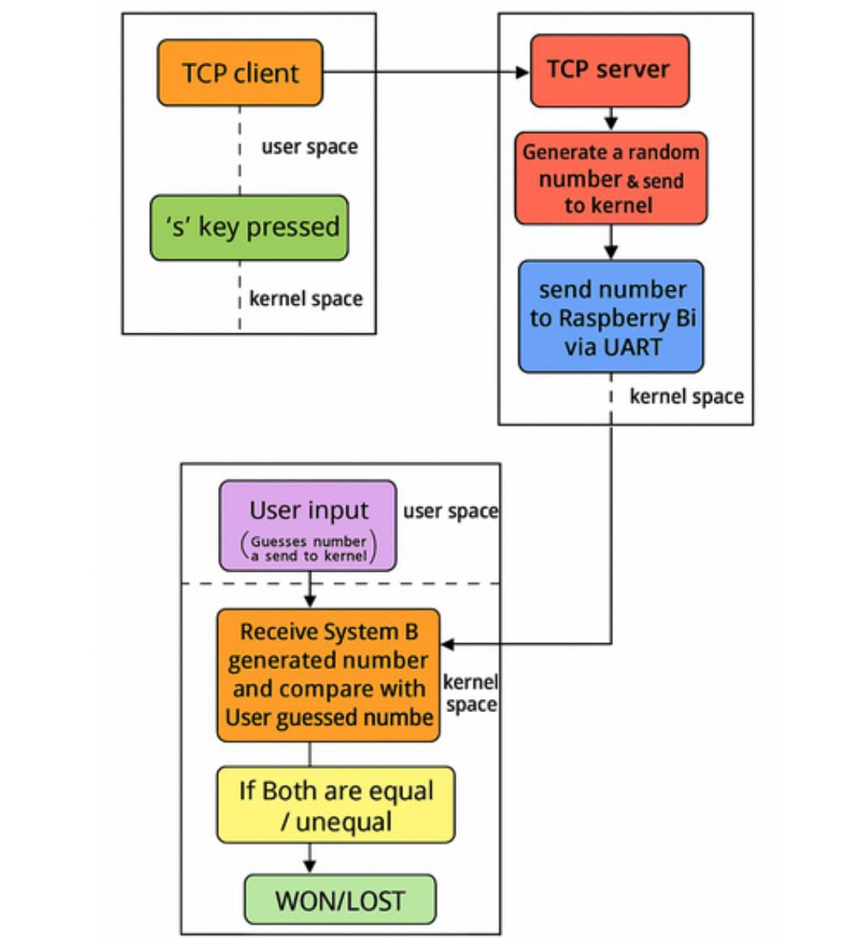
Workflow

Slide 4
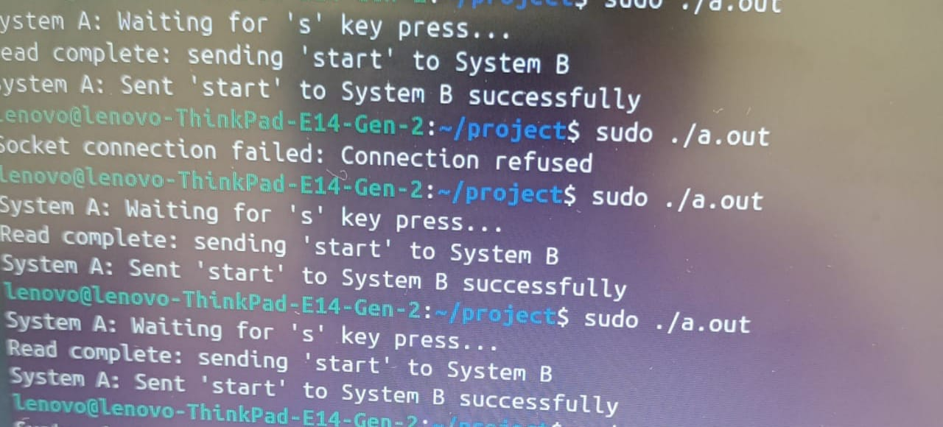
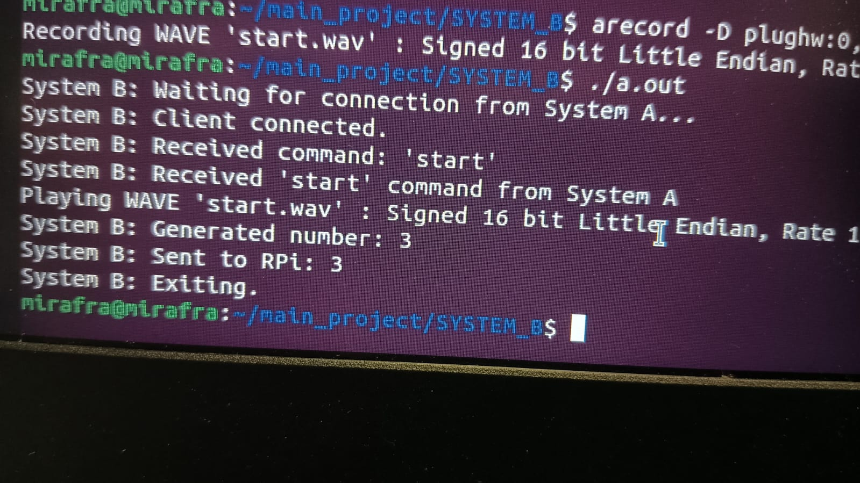
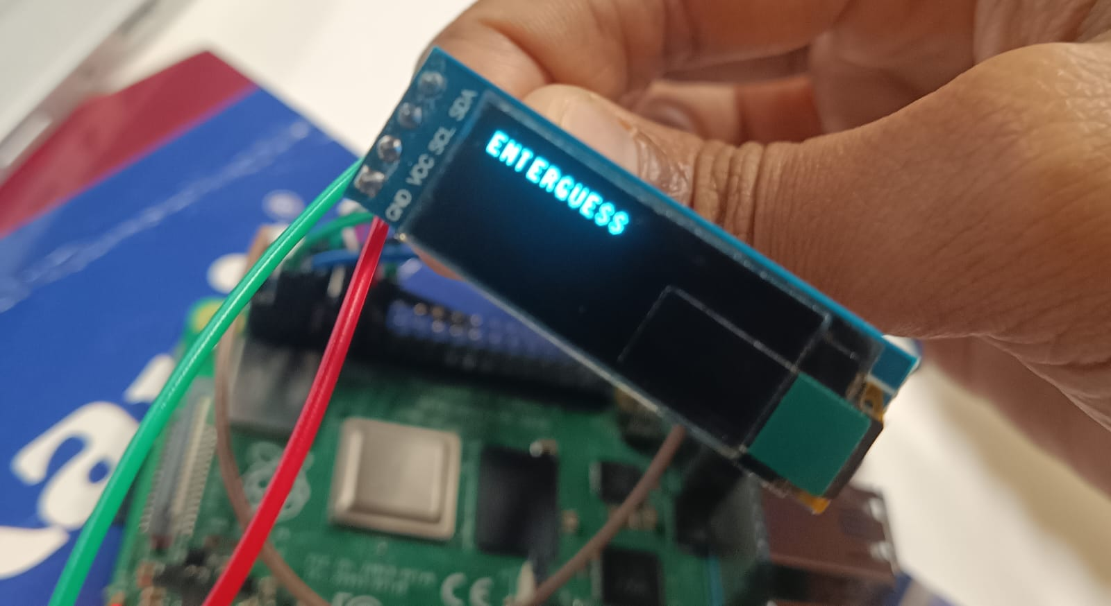
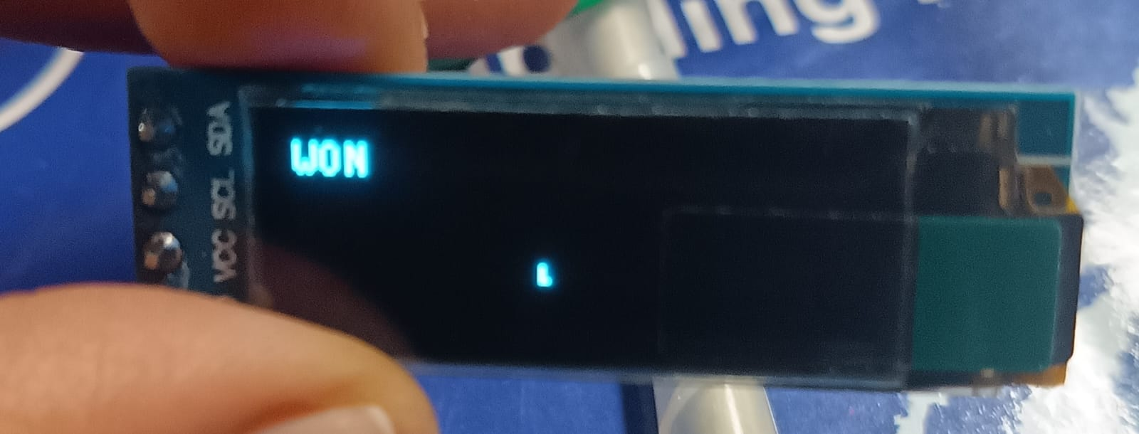
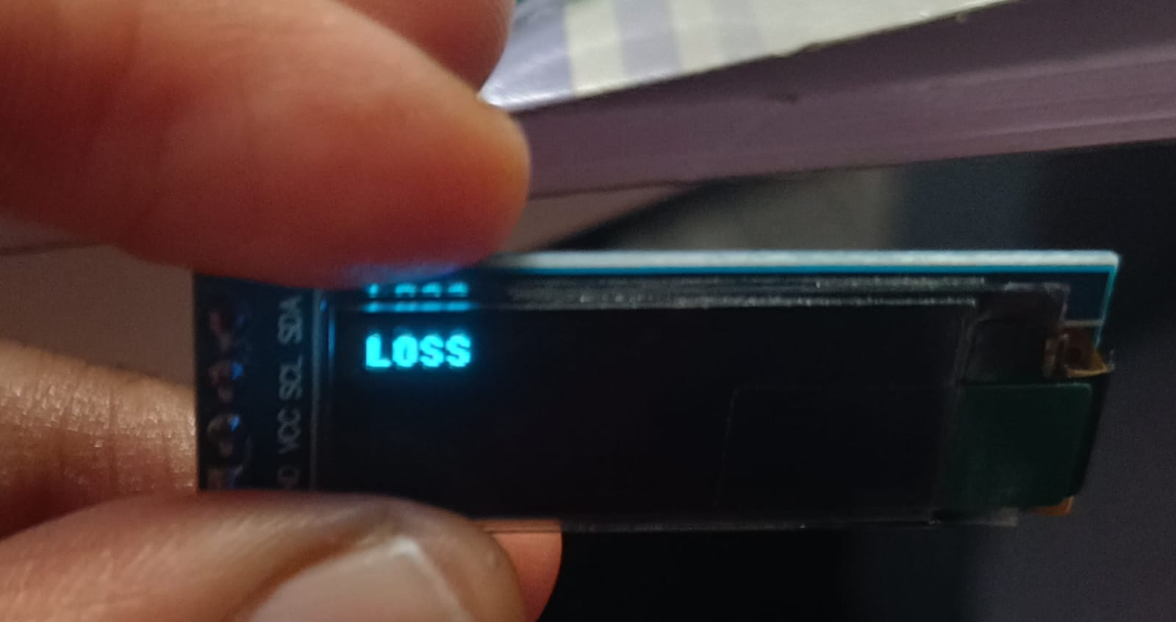
Screenshots & Result

